Slide 1
Acellus Training
Presented by:
Mrs. Butcher and Ms. O’Day

Slide 2
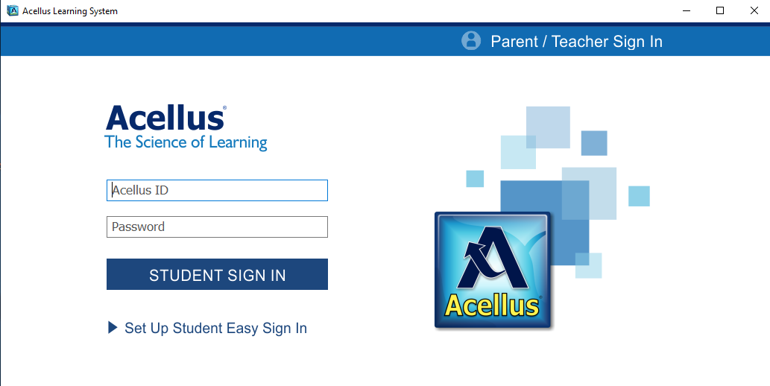
Teacher Sign In
Sign In with your district email. You will then need to create a PIN. Follow the on screen directions to verify your pin.

Slide 3
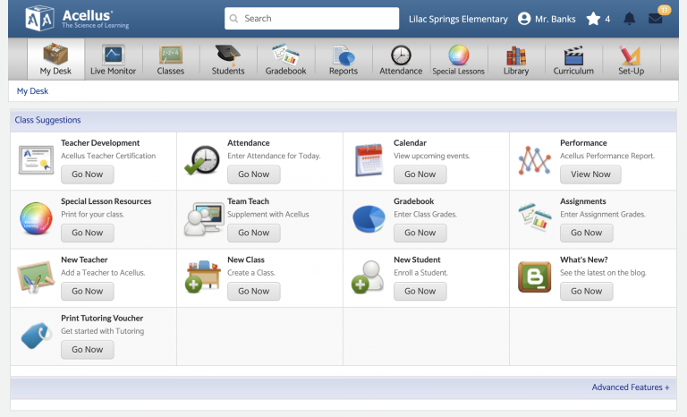
Teacher Portal

Slide 4
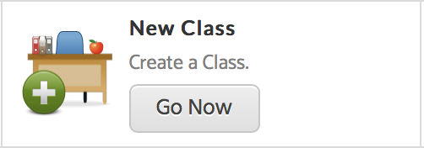
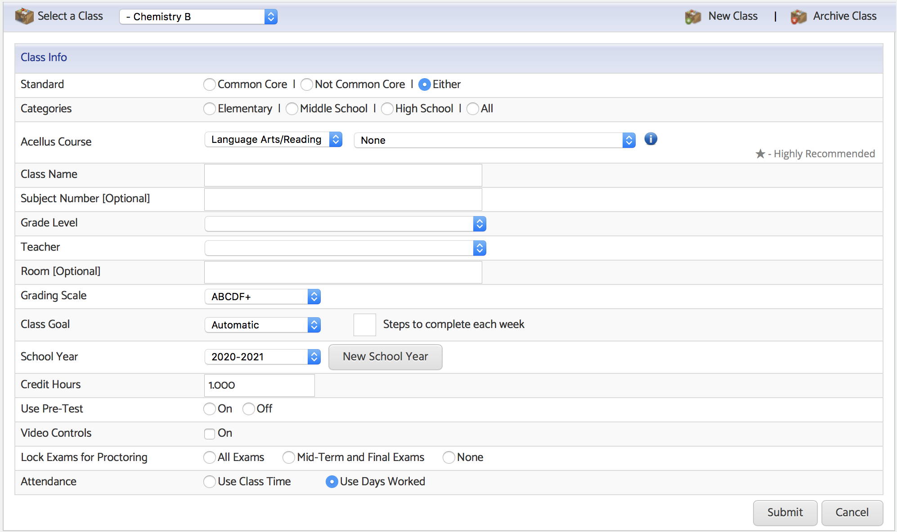
Creating a New Classes
Go to My Desk then select New Class.
Select Acellus Subject and Course
Fill out the Class Info form.
Set a Class Name. This is the name that you, your students, and your administrators will see for the class, so this name should be descriptive and unique.
Select the appropriate Grade Level.
Select the correct teacher.
The class goal can be set to automatic or manual.
Use the pull-down tool to set the Grading Scale to Custom Grading Scale.
The Pre-Test can be turned on or off.
Video Controls should be turned off. This requires that students must watch the entire video.
Decide if you would like your exams locked for proctoring.

Slide 5
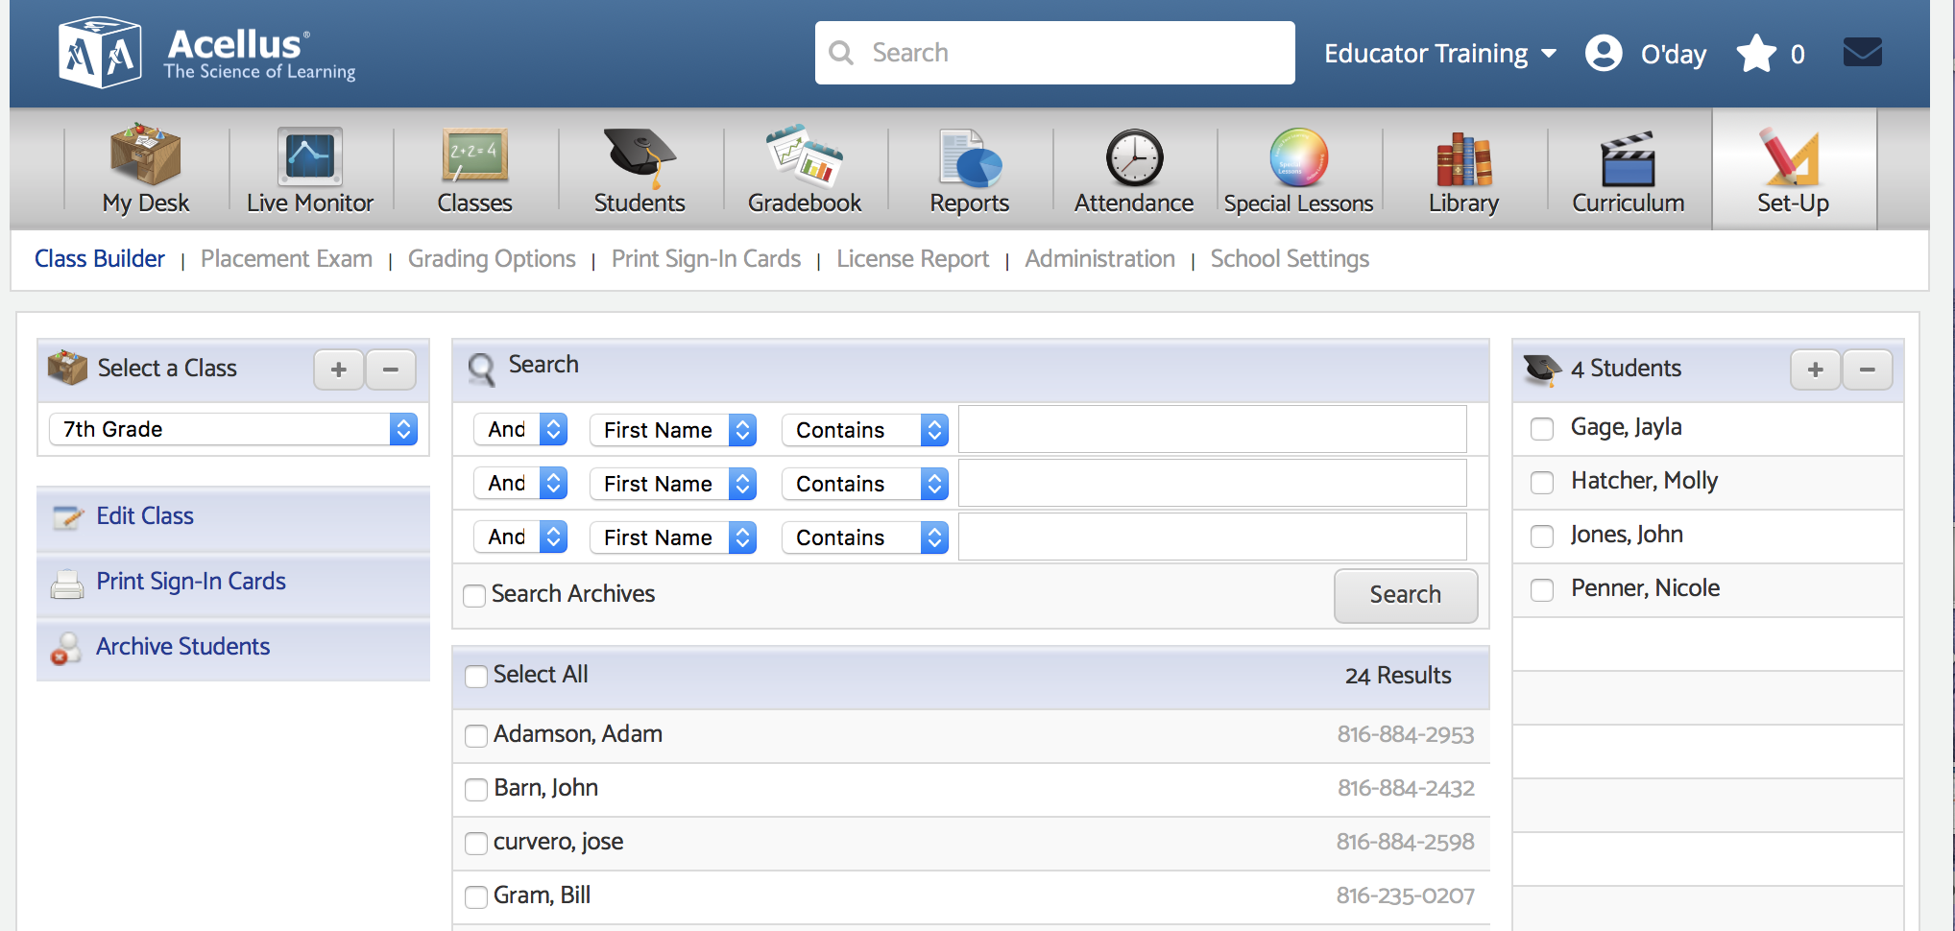
Adding Students to Your Class
Click on the Set-Up tab.
Select your class.
Use filters to search for specific students.
Click on the box next to their name to select that student.
Click "Add Students to Class."

Slide 6
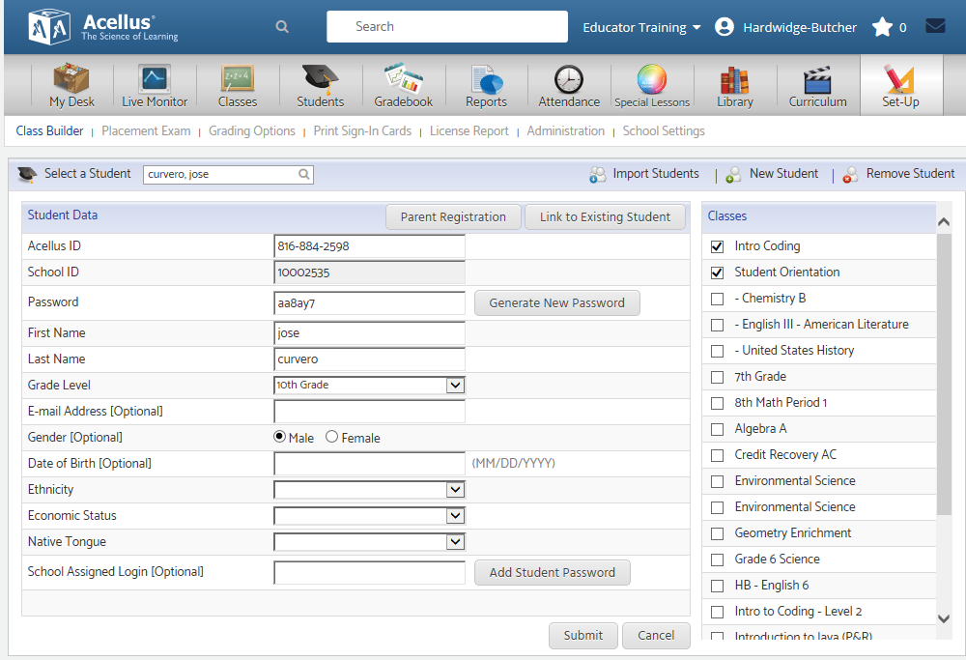
Parent Registration
Teachers can register parents by clicking on the Parent Registration button. You will need to enter the parent’s email address. Parents can then see the student grade report and time on task.

Slide 7
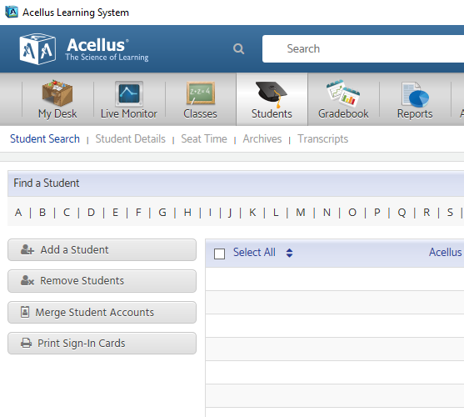
Printing Student Sign In Cards
From the Student Search screen, Select Print Sign-In Cards
On the Print Sign-In Cards screen that follows, you can select a class, then select the students you want Sign-In Cards for. Select Print Sign-In Cards to print a student’s Acellus ID and Password.
The Sign-In cards will appear, ready to print.

Slide 8
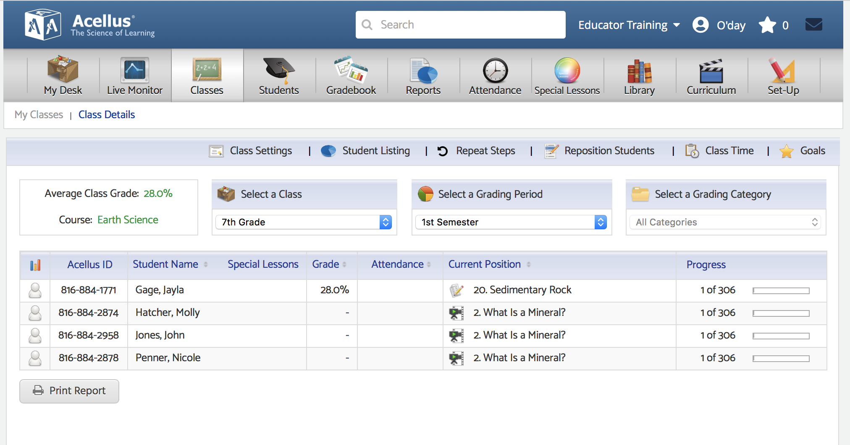
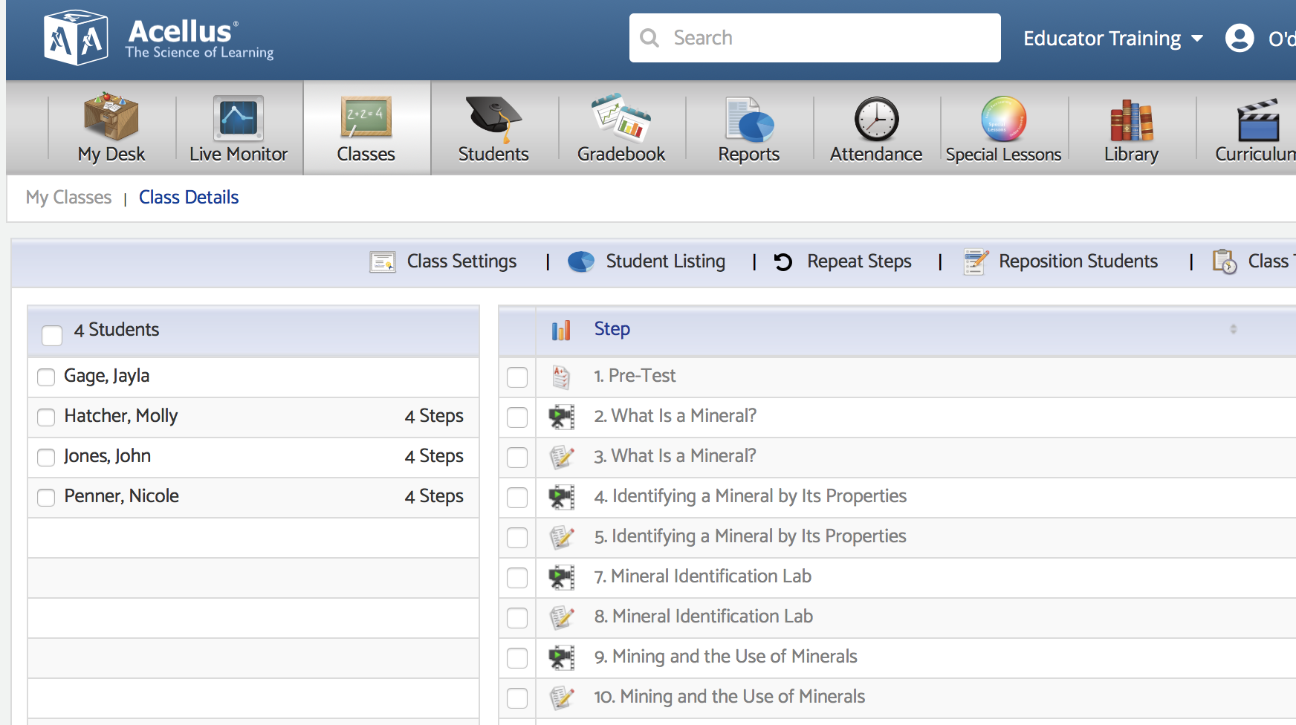
Managing Your Classes
Select a class to see overall individual student progress.
Select a student to see progress on individual steps.

Slide 9
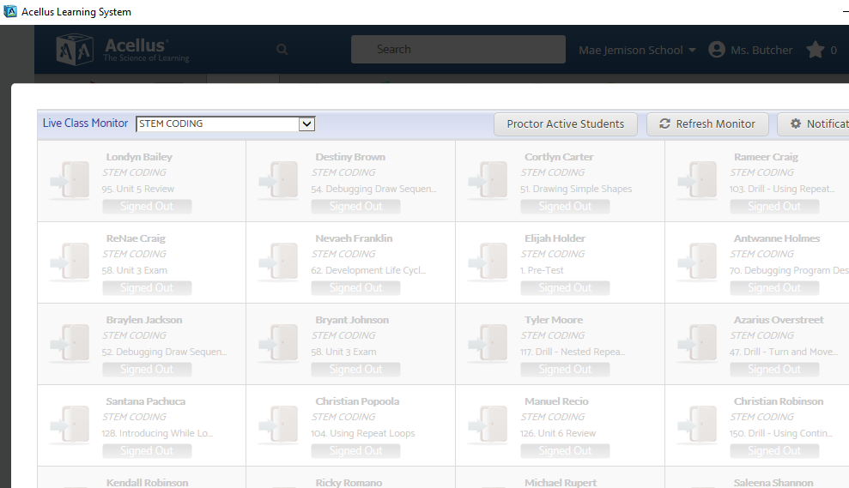
Live Class Monitoring
The Live Class Monitor screen presents a list of the students in the class and what –and how – they are doing at any given moment.

Slide 10
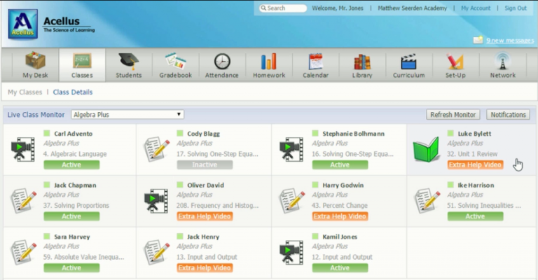
Live Class Monitoring
The Live Class Monitor is a tool that gives teachers live updates on student progress. The Monitor shows each student’s status and is color coded by priority like a stop light.
The GREEN Active status indicates the student is effectively progressing.
A YELLOW Extra Help Video status indicates that Acellus is slowing down and providing additional instruction on the concept at hand.
The RED Needs Help status indicates that’s the student is stuck and needs assistance.
By selecting on a student, the teacher has access to a detailed report showing the student’s mastery on every concept that’s been presented. By selecting on a concept the teacher can view every response alongside the acceptable answers and access the problem that was presented to the student.

Slide 11
Repeat Steps:
Set the students to repeat a given concept or set of steps. You can have students repeat video lessons, practice problems, or both.
Click on Classes tab.
Select a class.
Click on Repeat Steps button.
Select lesson/activities you want students to repeat.
Click Assign Repeat Steps.
*** Student will return to previous position once they complete their repeated steps.***

Slide 12
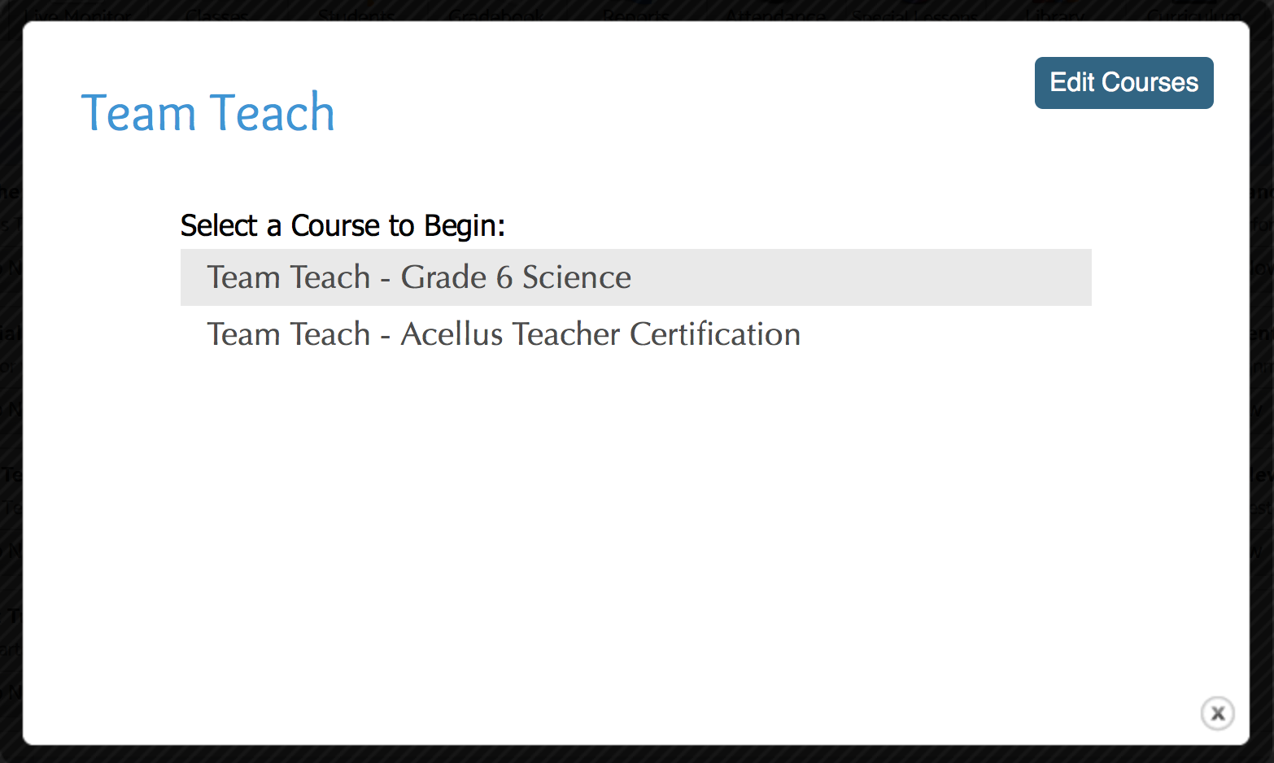
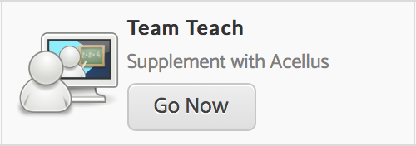
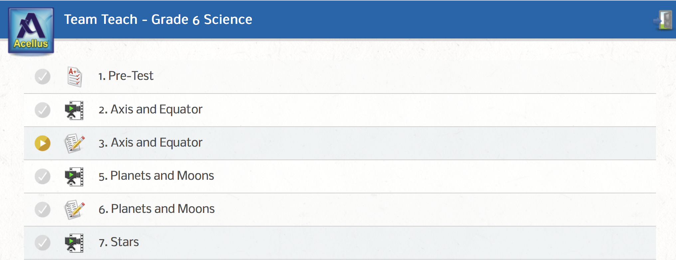
Team Teach:
Using Team Teach, teachers can view and display materials from a course in their classroom.
Click on Edit Courses to select up to 6 courses you would like to use with Team Teach.
Click on Team Teach button to open portal.
Click on individual steps/lessons to access the materials.

Slide 13
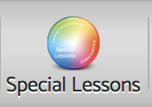
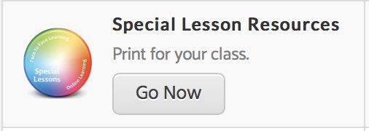
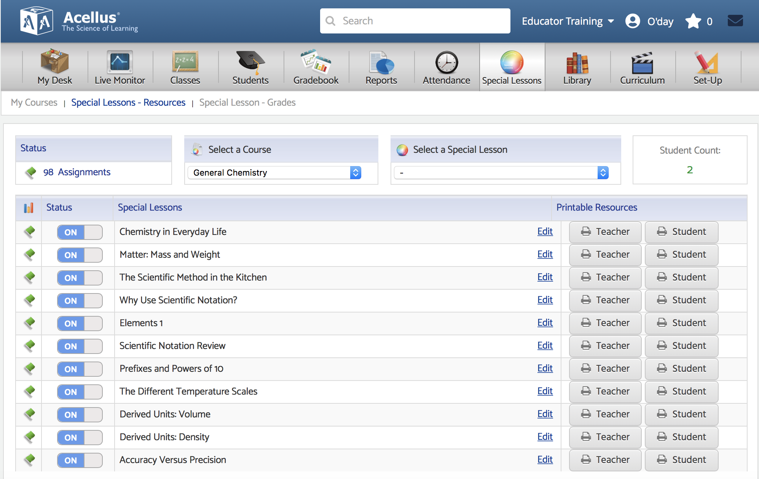
Special Lessons Portal
Special lessons are designed to provide teachers with pre-written lesson plans and student instructions/worksheets to facilitate the kinds of lessons that a computer just can’t do. These lessons may require students to complete a science experiment or research a topic.
The teacher can turn a special lesson on or off.

Slide 14
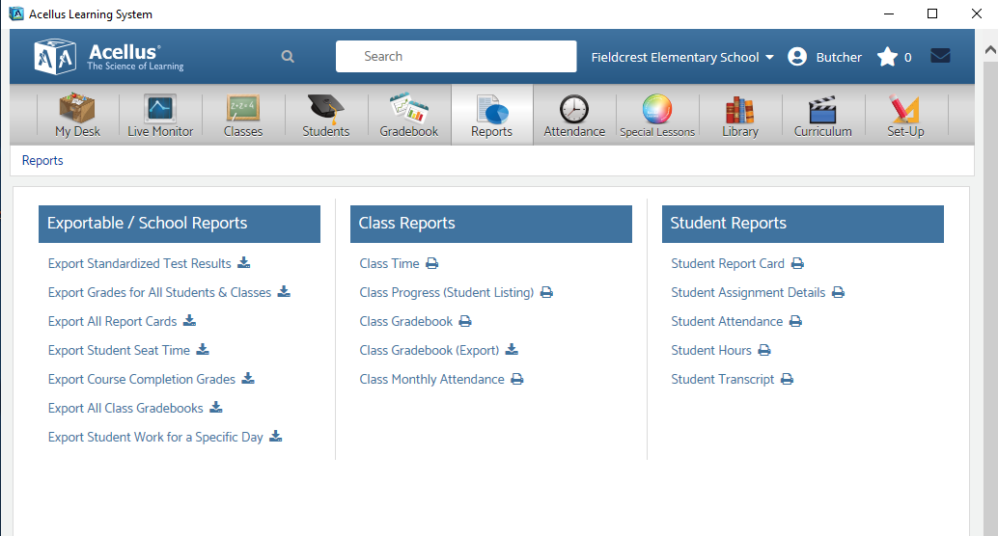
Acellus Reports
Various student reports are available. These reports contain overall grades and the amount of time spent on individual steps.

Slide 15
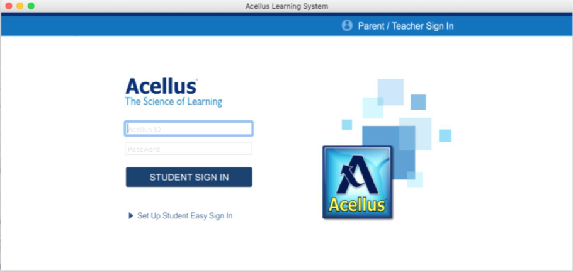
Student Sign In Screen

Slide 16
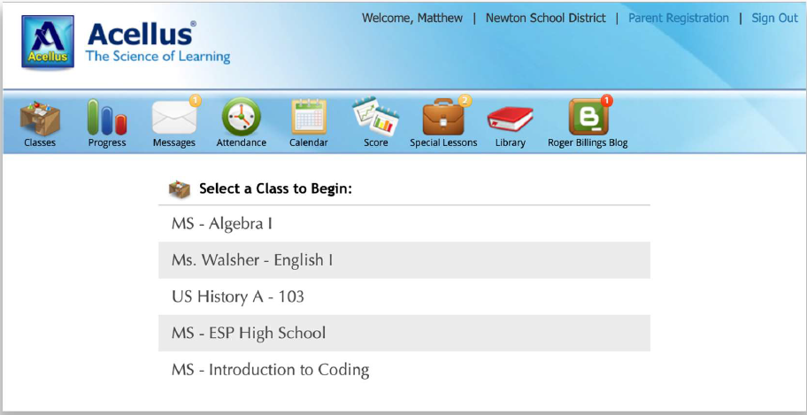
Student Interface

Slide 17
Acellus Videos
Acellus delivers short video lessons taught by teachers. Each concept taught in Acellus is presented in a separate video that is followed up with problems to test the students’ understanding of that concept.
Students can not advance the video during the first viewing. However, on subsequent viewings advancing is allowed.

Slide 18
Acellus Problems
Sample of the various Acellus questions that follow the videos.

Slide 19
Help Feature
Submit Problem Feedback- students can suggest correct answers, flag typos or out-of-date information, or even suggest that a problem is testing students on information that hasn’t yet
been taught.
The Textbook- contains written lessons that correspond with each video lesson in a course. Not all courses have a textbook.

Slide 20
Help Features
Problem-Solving Help - short, focused videos designed to help students learn how to solve the problems that are specific to the current concept.
Lesson Videos -which allows students to
access all of the available videos during the practice problems and reviews.

Slide 21
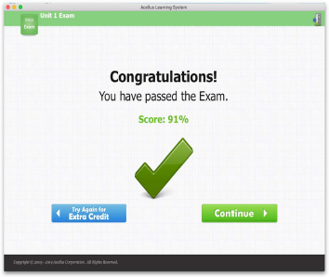
Exam Completion
When students fail an exam, they are automatically put into Exam Recovery Mode, where they can review the material they missed and then retake the entire Exam.
Students need to achieve a passing score of at least 70-75% to move on.

Slide 22
Special Lessons
Special Lessons are integrated into the courses so that they are assigned to the students as they progress through the course. When a student has a special lesson to complete a “bubble” will appear above the briefcase.

Slide 23
Student Progress
Students can keep track of their scores, giving them continuous feedback on where
they need to improve.

Slide 24
Notes

